Slide 1
ANOVA Technical Assistance Mobile Application Manual
Managing Technical Assistance with Mobile Phones

Slide 2
Table of contents
Goals: Understand basic mobile phone and CommCare operations Understand mentoring and facility modules Successfully conduct mentoring scenarios
Training Schedule
Application Overview
Getting Started: Basic Phone Operations
Menu Options
Application Overview
Selecting & Viewing Case Information
Filling in Case Data
Troubleshooting
Feedback

Slide 3
1. Training Schedule
Session | Activity | Estimated Time
1 | Icebreakers and Introductions | 20 min
2 | Overview of ANOVA Mobile TA Application | 40 min
Tea break – split into groups
3 | Handout phones, Logging in with username/demo mode Basic phone operations | 30 min
4 | Clock in/Clock out | 20 min
5 | Facilities Assess Facility Record Direct Support Record Health Care Strengthening Register Mentee List Information | 1 hr
6 | Try it out- everyone creates themselves as a new mentee under the test facility. | 30 min
Lunch Break
7 | Mentees Assess Mentee Record Mentoring Record Training List Weaknesses Record Consultation List Information | 1.5h
8 | Assess a Mentee and record a mentoring session – Case Studies | 45 min
9 | Role Playing in mentorship

Slide 4
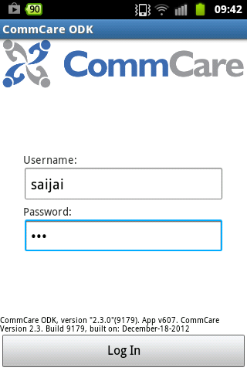
2. Getting started
How do I login to CommCare?
STEP 1: Click on the CommCare icon on the home screen on your phone
STEP 2: You will see the login screen, from here type in your username and password!
The first time you log in- You must have internet connectivity. After pressing “Log In” for the first time, there will be a few moments during which CommCare makes sure that the information on your phone is up-to-date with the server (see right image).
After you log in the first time- Even if you log out and then log back in (with the same username) you do NOT need internet connectivity.
The Home Screen
Get Started: This is where you will go in order to access the forms and submit data.
Saved: Stores completed ,
submitted, and unsent forms. You can select a form from the list in order to review the data.
Incomplete: Stores forms that are only partially complete, or have not been submitted in their final form. By clicking here you will get a list of incomplete forms. You can choose a from the list to open and complete it.
Sync with Server: Forces phone to synchronize with the data on the server. The text below the button will tell you if there are pending forms. If there are a lot of pending forms the text will turn red to alert the user. If you have forms you want to force the phone to submit, you can press “sync with server.”
Log Out of CommCare: Logs the user out so that the data on the phone is secure.

Slide 5
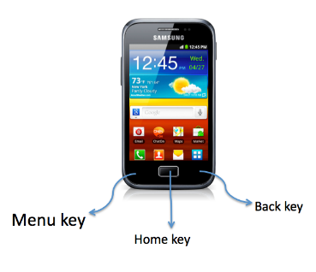
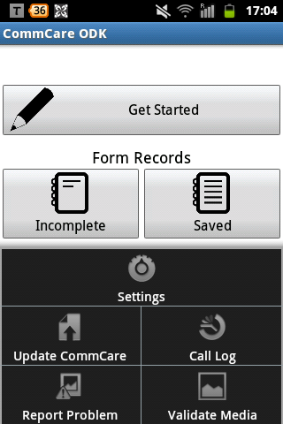
3. Menu Options
What is the menu button?
Use the menu button in CommCare to get to advanced features like automatically updating CommCare!
Update CommCare tells the device to check if there is a more recent version of the application. If there is, CommCare will update (connectivity required) and you will need to log in again.
Settings allows you to clear user data and forces the phone to submit technical metadata to the server.
Report Problem Allows you to report the issues that you are having with CommCare.
Call Log shows a record of all calls/messages that originated from CommCare.

Slide 6
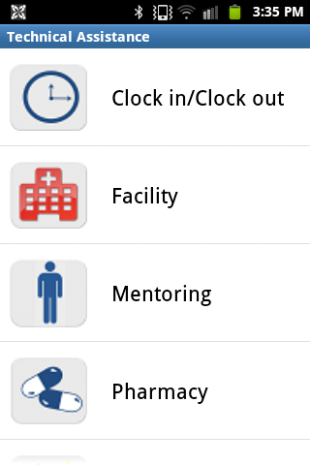
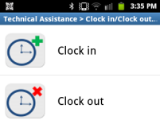
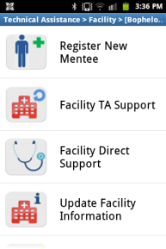
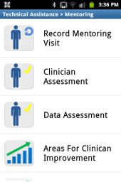
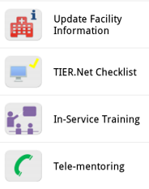
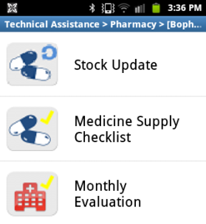
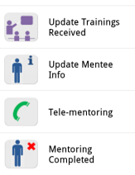
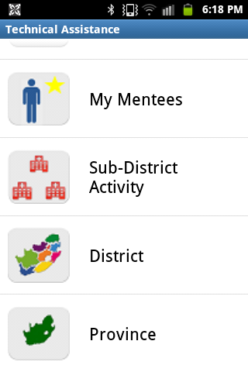
4. Application Overview
Where do I find things?
Modules
Clock In/Clock Out Forms
Facility Forms
Mentoring Forms
Pharmacy Forms
Advanced Modules
Gives a list of your personal mentees
Enters activities done on a sub-district level
Enters activities done on a district level
Enters activities done on a provincial level

Slide 7
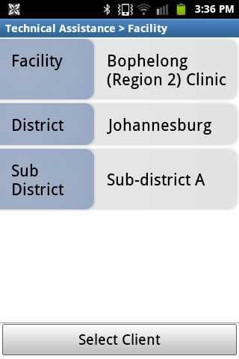
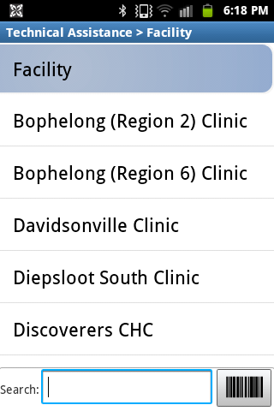
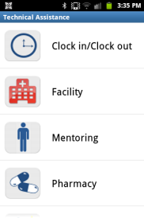
5. Selecting & Viewing Case Information
What is a case?
A Case is something being tracked overtime. In our application, the cases are Facilities and Mentees. All information entered is tracked at these levels.
Case List
Case Details
The case details gives you information about each facility and mentee. It is important to browse the information before moving forward to make sure you have the correct case.
The case list provides all of the cases for a given module.

Slide 8
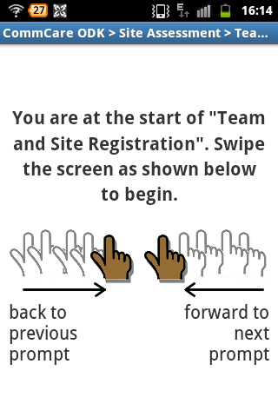
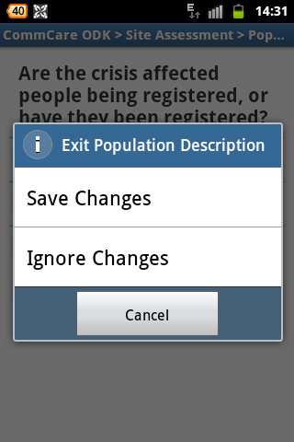
6. Filling in Data
How do I Navigate in CommCare?
Swiping to next question
GPS Questions
When you reach a GPS question, you will be presented with a "Record Location" button. Once the location is displayed in your form, you simply swipe to go on to the next screen. Selecting "Record Location" again will re-initiate the GPS capture process and can overwrite the first set of coordinates.
Pressing the back button during form entry results in a popup asking whether changes to the form should be saved. you will get three options:
Save Changes: the current form will be saved and marked as incomplete.
Ignore Changes: deletes any changes you made/data you entered and brings you back to the home screen
Cancel: brings you back to the form you were working on

Slide 9
7. Trouble Shooting
What do I do if it doesn’t work?
There are a number of ways for the CommCare application to end up in a non-functional state. This document outlines a triage procedure for resolving a problem you are experiencing. If you still can't resolve your problem or your problem isn't listed below, please email the CommCare users Google group (commcare-users@googlegroups.com) with the details of your problem.
Syncing With Server Fails (or takes a long time)
Pressing the Sync with Server button on the home screen takes a really a long time or results in a message stating "Couldn't contact server. Please make sure an internet connection is available and try again." Make sure that you have network connectivity (you should see a little E, G or H in the top left corner of your phone, or be connected to a WiFi network). To fix network connectivity issues:
Verify that there is credit on the phone
Verify that you can connect to the internet (use the browser to navigate to www.google.com).
Verify that the APN settings are correct (see the phone setup guide - Phone Setup)
Application Not on Home Screen
The CommCare application is not on your home screen. It may have been removed by accident. Select the "Applications" icon on the home screen (in the lower right hand corner) and search for the CommCare icon. You may need to swipe left and right to find it. If the CommCare icon is found, add it to the home screen by pressing and holding it. If it wasn't found, you will need to reinstall it.
Login Issues
When trying to login, you receive a message stating "Authentication Failed on Server. Please check credentials and try again." Check that the username and password are correct.
When logging in, you receive a message stating "Couldn't contact server. Please make sure an internet connect is available and try again.” If this is the first time you are logging in the phone, check that you have network connectivity. Details on fixing network connectivity are below. If you don't have any network coverage, make sure that the "Sync with Server" checkbox is not checked on the login screen.
CommCare Application is Not Installed
When trying to install, you receive a message stating "A serious problem occeured while CommCare was trying to download an update (or install your app) CommCare couldn't find the resource with resource id: commcare-application profile." Meaning that it could not install from HQ, to address this, use the setup guide to install the application and check whether your phone is Android 2.2 and above.
Data Does Not Update in Application
When using the application, the information you create and register a new group and it doesn't appear in the list for a collection visit. Alternatively, after you do a collection visit with a group, the information does not appear to be updated when selecting that group for another visit.
This may be caused by unchecking the "Mark as Finalized" button prior to saving the form (it should also be marked in green prior to saving and closing the form). Go the main screen of CommCare and select "Saved Forms”. If there are any forms in the list, open them and complete them. Make sure that "Mark as Finalized" is set prior to complete the forms.

Slide 10
8. Case Studies
CLINCAL MENTEE #1:
Clock in at the facility
Register a new mentee who’s name is sister Agnes
Conduct the clinical assessment with Agnes, she scores 1 and 2 on some
At this session we cover history taking and general examination. We also discuss baseline monitoring of bloods and drug regimen. You demonstrate 1 initiation and she does the other intimations. You spend three hours with Agnes and she is very tired by the end
Move on to a previously mentored sister at the TB clinic, you discuss 3 problem cases and review the registers, spending about 1.5 hours.
Before leaving you clock out
CLINCAL MENTEE #2:
Arrive at facility
Go to TB (existing mentee) 2 hours, covered 3 areas
Go to ANC , competent mentee but has difficult cases, spend 2 hours there providing technical asstance
Receive 2 telephone consultations for 10 and 15 minutes for another clinic
Identify a problem at ANC, go discuss it with policy manager – 30 min
Clock out
PHARMACY MENTEE:
Arrive at facility
Conduct the facility assessment
Record the stock at the facility
Register the pharmacy assitant as a mentee and record a session with them where you go over stock management and ordering stock.
DATA MENTEE:
Clock in at facility
Complete the TIER.net checklist. This is a clinic that needs a lot of support. They have a lot of defaulters and have not backed up their data in over a month
Register a new mentee (you found someone who was trained by ANOVA)
Complete the mentee data assessment form
Identify challenges in the clinic
Respond to action in these ways:
Training
Intensive mentoring
District involvement
CLINCAL MENTEE #3:
Arrive at the facility and clock in
Conduct a clinical assessment with Agnes
Go through all 54 competency question
Agnes scores a 3 and a 4 this time on almost all of the questions
Mentoring is completed so you clos the mentee
You identify a new mentee at the clinic and register them.
You also spend some time in the
Write your own case study below and switch with your partner!
Notes:
done

Slide 11
9. Feedback
What are 3 main ways you will use this application?
What would you like to see added to the application?
What is your favorite part of the application?
What is your least favorite part of the application?
Please answer YES or NO the following questions
I feel confident about using this application _____
The training provided me with information I could not have figured out on my own ___
I will need more help in understanding the application in the future ____
The training was sufficient in length ____
Any additional comments about the application or training:

