Slide 1
20 is the magic number! There are 20 phone preparation steps.

Slide 2
3 main stages
Preparation Steps 1-7
User Friendly Steps 8-12
Application Functioning 13-20

Slide 3
Preparation Steps 1-7
1. Phones is fully charged
2. Phone is labeled correctly. Inside and outside label.
3. Phone has SIM and SD card available.
4. Set up Internet Connectivity
5. Set up GPRS settings
6. Set correct date/time
7. Install Media folder into the SD card (helpful if media is large)

Slide 4
Preparation Steps 1-7
1. Phone must be fully charged.
Why: Saves Time
How: Charger. Know by charge icon.
2. Phone must be labeled inside and out
Why: Organization, tracking.
How: CARE
3. SIM and SD card
Why: SIM to send data to server/sync. SD to hold application.
How: CARE

Slide 5
Preparation Steps 1-7
4. Set up Internet Connectivity
5. Set up GPRS Connectivity and Check GPRS settings
Why: Send Data to Server/Sync
How:
New SIM - Three SMS messages will appear.
Call Provider
Text MO to 54321
Manual set up

Slide 6
Manual GPRS Set Up
GPRS Settings → Menu -> Settings -> Configuration -> Personal config. sett. Options -> Add new -> Access point
Access point settings -> Bearer settings -> Packet data acc. pt. to airtelgprs.com
Go Back twice. Select “Options -> Activate
Go to "Menu -> Settings -> Configuration -> Default config. sett. – Make sure a web setting is listed here.
Go to "Menu -> Settings -> Configuration" and select "Act. def. in all apps.

Slide 7
Checking GPRS settings
Menu -> Settings -> Configuration ->
Default config settings: XXX
Preferred access pt: XXX

Slide 8
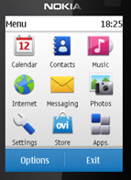
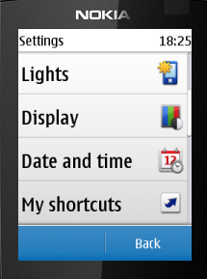
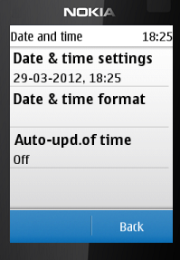
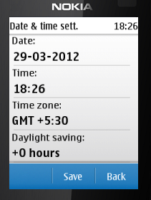
Preparation Steps 1-7
6. Set correct date/time
Why: Reporting real time
Change the time zone to GMT+5.5 (India time is 5.5 hours ahead of GMT- Greenwich Mean Time)
How: Enter the date (dd/mm/yy) and time

Slide 9
Preparation Steps 1-7
7. Install Media folder into the SD card
Why: Media used in application
How: Must be done using computer. Download media file to SD card.

Slide 10
Who can recall steps 1-7

Slide 11
User Friendly Steps 8-12
8. Phone Volume to Maximum
9. Undo Text Predictions
10. Set writing language to Hindi
11. Set phone language to Hindi
12. Main Screen blank

Slide 12
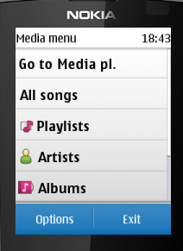
User Friendly Steps 8-12
8. Phone Volume to Max
Why: Audio Function
How: Main Screen –> Menu – > Media –> Media Player –> Go to Media Player –> volume icon located on bottom right of screen –> press Up button until volume at maximum

Slide 13
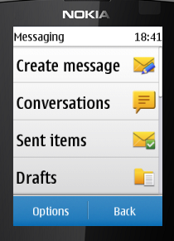
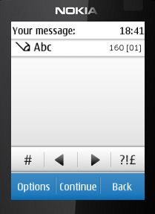
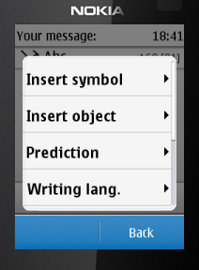
9. Undo Text Predictions 10. Set Writing Language to Hindi
How: Menu –> Messaging –> Create Message –> Message – > Scroll down to Message Box –> Options –> Prediction Options –> Status –> Off
Options –> Writing Language –> Hindi
Why: Text input questions.
Notes:
If in the application, this can also be done from the Options choice in the text input box.

Slide 14
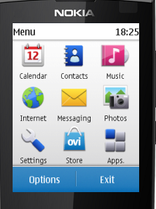
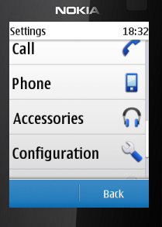
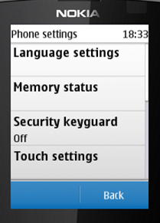
11. Phone Language to Hindi Why: Hindi Language easier for user
How: Main Screen –> Menu –> Settings –> Phone –> Language Settings –> Hindi

Slide 15
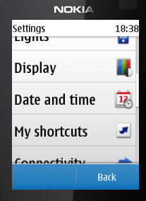
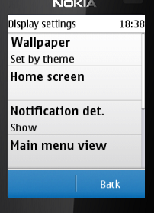
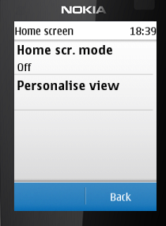
12. Set Main Screen Blank
How:
Menu –> Settings –> Display –> Home Screen –> Home Screen mode –> Off
Why: Less Distractions

Slide 16
Who can recall steps 8-12?

Slide 17
Application Functioning 13-20
13. Install Application
14. Move Application to Games Folder, Turn phone Off and On.
15. Set permission for the application.
16. Test Network Connectivity
17. Restore User
18. Set ‘Do not Disturb’
19. Opt in to Dimagi Gateway
20. Create Shortcut

Slide 18
Application Functioning 13-20
13. Install Application
How: Phone to Phone Installation
Source phone: Phone with the correct installation of the application and latest multimedia files. Make sure the application has no data (case data, registered user, etc). A fresh install is best.
Destination phone: The phone on which you want to install the application.

Slide 19
Application Functioning 13-20
Install Application Continued..
1. Source Phone: Application in Games Folder (local memory)
2. Place destination phone’s SD into Source phone.
3. Copy Application from Games to SD card.
4. Place SD back in destination phone and continue with phone prep.

Slide 20
Application Functioning 13-20
14. Move application from SD card to Games Folder (local memory).
***Turn phone off and back on again before continuing to other steps.

Slide 21
Application Functioning 13-20
15. Set Application Permissions
Why: Allow media/data to be used.
Navigate to the CommCare application. Press Options located on the bottom left hand corner. Navigate to Application Access.
1. Communications –> Network Access –> Always allowed
2. Data access –> Read User data –> Always allowed
3. Data access –> Add and edit data –> Always allowed
Notes:
Permissions will get erased if the Application is moved back to the SD card or if a new Application is installed.

Slide 22
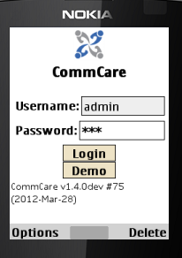
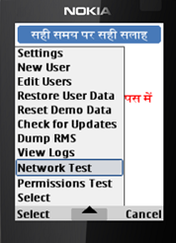
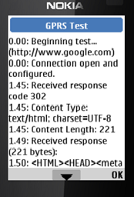
Application Functioning 13-20
16. Test Network Connectivity
Why: Make sure GPRS is working.
How:
Sign in as ‘Admin’ Password 234

Slide 23
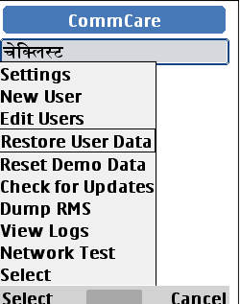
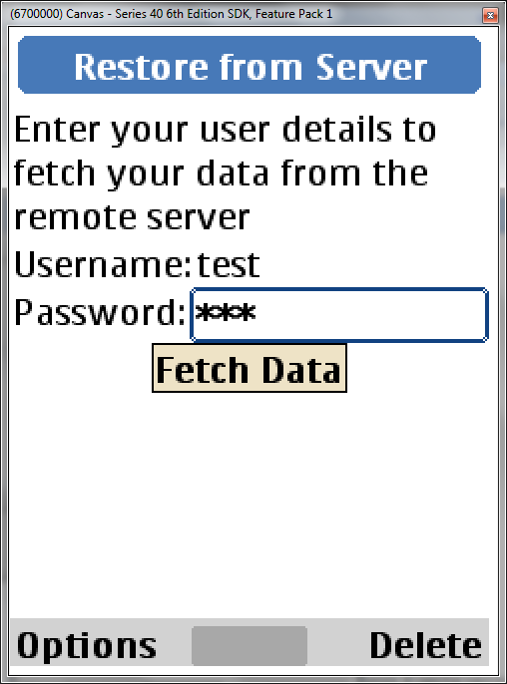
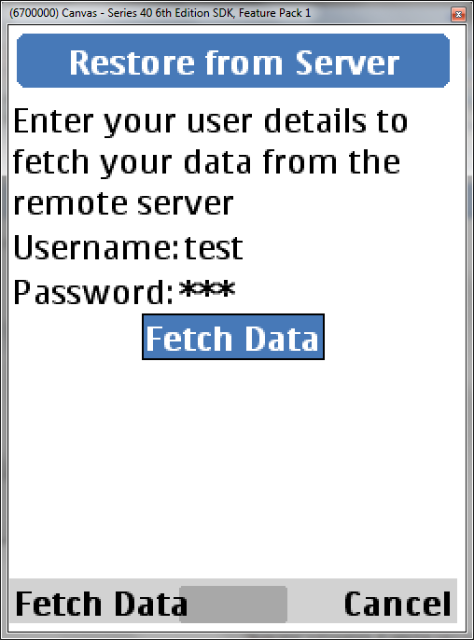
Application Functioning 13-20
17. Restore User
Why: Match Front Line Workers work with phone
How: CARE will have all usernames and passwords

Slide 24
Application Functioning 13-20
18. Set ‘Do Not Disturb’
Why:
How: SMS ‘START 0’ to 1909
19. Opt in to CommCare Gateway
Why: Receive Messages from CommCare Server
How: SMS 'START to +917760962755

Slide 25
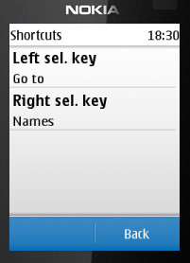
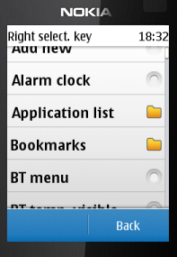
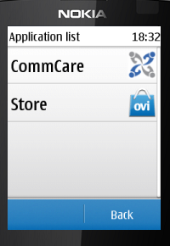
Application Functioning 13-20
20. Create Shortcut for Commcare, ***Open CommCare after Shortcut is set.
Why: Easy to Find
How:
Menu- Settings –> My Shortcuts –> Right Selection Key –> Application List –> CommCare

Slide 26
Who can recall steps 13-20?

