Slide 1
Troubleshooting

Slide 2
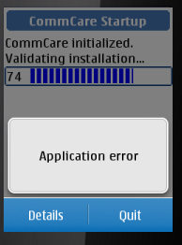
What is an ‘Application Error’ and how do I fix it?

Slide 3
There are several reasons for an Application Error message to appear. When an Application Error appears
first click "More Details" to get more information about your specific error.
** The "details" may be difficult to interpret but look for useful and understandable phrases.

Slide 4
Error: FILE NOT FOUND
If you see the phrase "File not found“
Missing audio or images. Identify which file and copy from your source phone.
If entire media folder deleted, will need to reinstall.

Slide 5
Error: SOUNDS NOT ALLOWED
If you see the phrase "Sounds not allowed",
Exit CommCare.
Navigate to: Settings>Tones>Application Tones
If the setting is set to "Off", switch to "Yes".

Slide 6
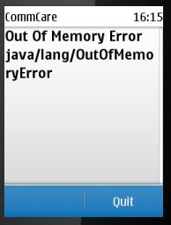
Error: Out of Memory
If you see a phrase ‘Out Of Memory’
Quit the application and try to reopen the CommCare application.
If this continues to happen,
please report this bug.
Need to note exactly where
this happened.

Slide 7
Error
Message read “IO Exception [error in HTTP operation].
Problem with Network connectivity.
Run Network test.
Check GPRS settings
Check phone balance

Slide 8
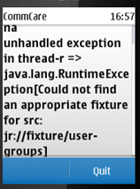
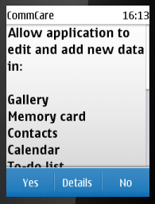
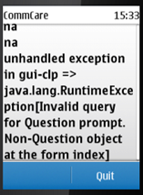
What to do?

